Slide 1

Tax Calculator
by
Manas Sati
(902216)
Prapti Hazra
(901468)
Shweta Rawat
(902483)
Achalla Keerthana(902224)
Under the guidance of
Deepa Thangaraj

Slide 2
Index
Problem Statement
Objective & Aim
Introduction
System Requirements
Modules Implemented
Methodology
Output
Conclusion & Future Scope

Slide 3
Problem Statement:
To Develop a simple java application to calculate the tax for a particular employee based on his salary by creating a class named “TaxCalculator” with a method named calculateTax with some parameters and various other classes and models as needed.
The program should be able to validate the data entered by the user and calculate the tax as per his salary and store his details into the database.

Slide 4
Objective & Aim:
The main objective of this application is that an individual can calculate their tax liability in a contemporary and convenient way.
The aim is to implement JDBC and store Employee data into database.

Slide 5
Introduction:
Tax calculator is an online tool, which is specifically designed to help the taxpayers with their basic tax calculations.
The project will take employee details and will calculate tax based on certain conditions and will return the final salary.
So, in this project, the tax calculator gives exceptions like name, nationality and salary and then tax is calculated accordingly.
In the end, we have used JDBC to successfully store the employee data into the MySQL database.

Slide 6
System Requirements:
Software:
Eclipse
MySQL workbench
Hardware:
A laptop with good specification with a minimum of 4 GB RAM

Slide 7
Modules Implemented
1. Scanner
2. Access modifiers
3. Operators, Loops
4. Flow Control
5. OOPS, Constructor
6. Abstract Classes or Interfaces
7. Java Utils (Date, Calendar)
8. String, StringBuilder
9. Arrays
10. Collections – List, Map
11. Wrapper
12. Exception Handling
13. JDBC

Slide 8
Methodology
Step 1. Create a class taxCalculator and its constructor, define get, set methods and other variables.
Step 2. Add calculateTax function and define the logic to calculate tax
Step 3. Create a class CalculatorSimulator and take input from user
Step 4. Create objects of taxCalculator and calculate tax
Step 5. Perform necessary validations
Step 6. Throw exceptions, wherever necessary
Step 7. Register the driver class and create connection
Step 8. Create a table
Step 9. Input values into the database using preparedStatement

Slide 9
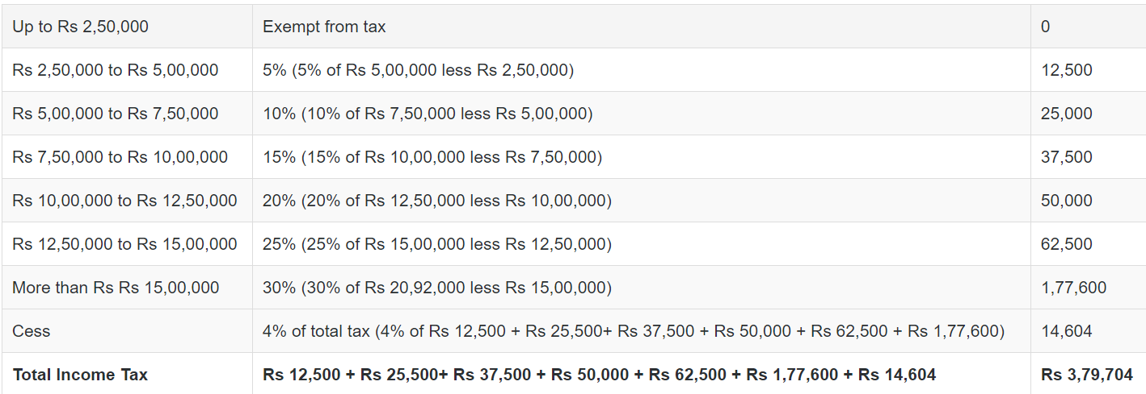
Tax Exemption Table

Slide 10
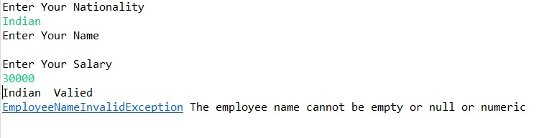
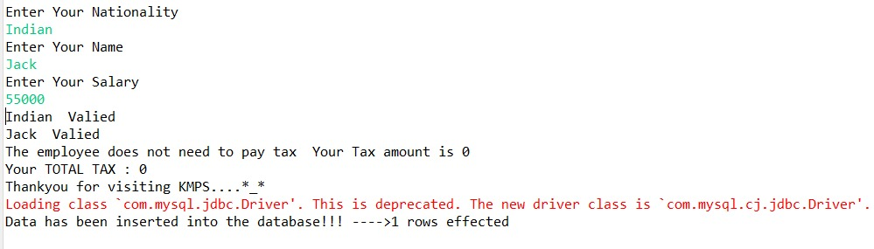
Output
Test Case 1
Test Case 2

Slide 11
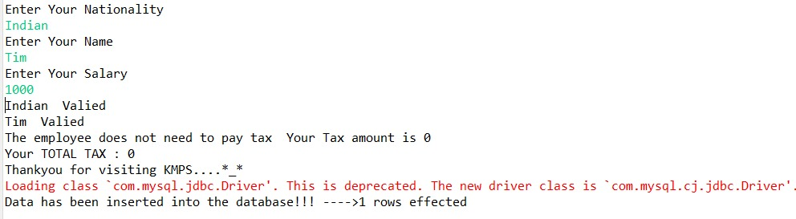
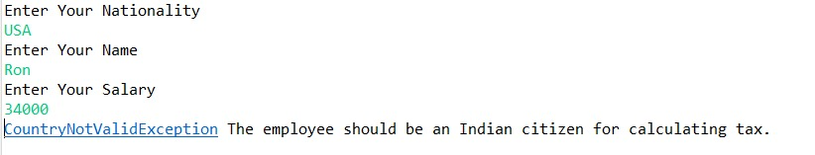
Output
Test Case 3
Test Case 4

Slide 12
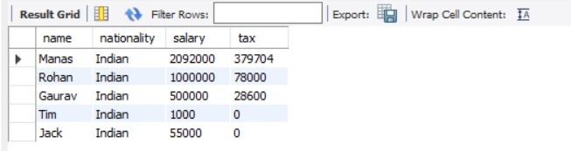
Output
Employee Data

Slide 13
Conclusion and Future Scope
While developing the system a conscious effort has been made to create and develop a software package, making use of available tools, techniques and resources – that would generate a proper system for TAX CALCULATOR. While making the system, an eye has been kept on making it as user-friendly.
As such one may hope that the system will be acceptable to any user and will adequately meet his/her needs.

Slide 14
Thank You!!!

